Slide 1
Taking off planet Textbook
Ladislav Václavík
Masaryk University Language Centre

Slide 2
Outline
Textbooks and LA
ICT and autonomy (Quizlet, Edmodo)
Students’ reactions

Slide 3
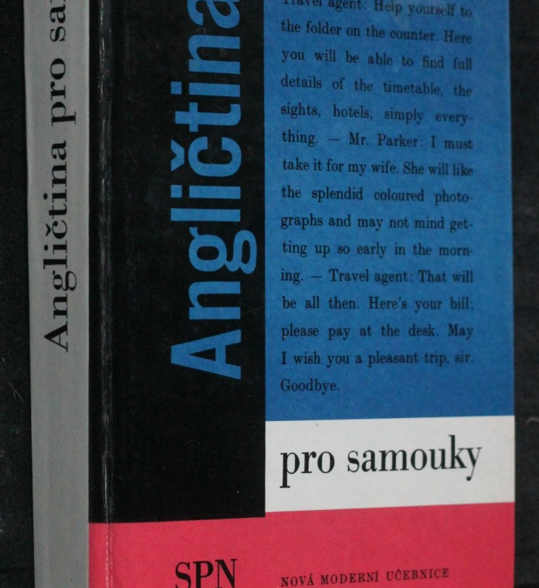
Teach yourself fly with…
On (not) being autonomous

Slide 4
Textbooks and autonomy totalitarianism and democracy

Slide 5
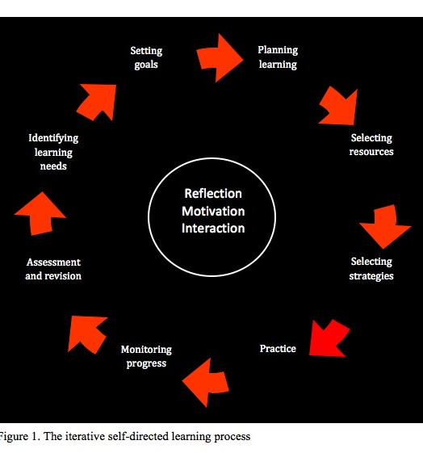
Textbooks and autonomy
Reinders and Balçikanli (2011) – framework for self-directed learning
Textbooks investigated promote just two of the steps

Slide 6
Planet Textbook
Kesen (2010) – students view textbooks as
a foreign country
a secret garden
a planet

Slide 7
Business news In-class mini-projects
- involvement
- self-reflection
- TL use

Slide 8
Identifying needs Setting goals

Slide 9
Students expectations

Slide 10
Business news
Extensive reading
Authentic materials

Slide 11
Selecting resources

Slide 12
Selecting strategies
Which words? How to learn?

Slide 13
Quizlet.com vocabulary strategies
How to learn
How to discover
How to consolidate

Slide 14
Quizlet vocabulary sets
Open to add
Open to modify
Open to access

Slide 15
Practice

Slide 16
Textbook business vocabulary

Slide 17
Plan Monitor Evaluate

Slide 18
Quizlet Flashcards

Slide 19
Quizlet Learn

Slide 20
Quizlet Write

Slide 21
Building business vocabulary

Slide 22
Planning Which words?

Slide 23
Business news wordlists – discovering

Slide 24
Quizlet Live consolidating

Slide 25
Quizlet Live – modes

Slide 26
Quizlet Live Contest

Slide 27
Monitoring progress

Slide 28
Quizlet Monitoring

Slide 29
Quizlet Monitoring

Slide 30
Assessment

Slide 31
Quizlet Evaluating

Slide 32
Mini-projects

Slide 33
Edmodo.com
Create
Share
Collaborate

Slide 34
Edmodo.com
Self-access
Discussion
Feedback
Reflection on feedback

Slide 35
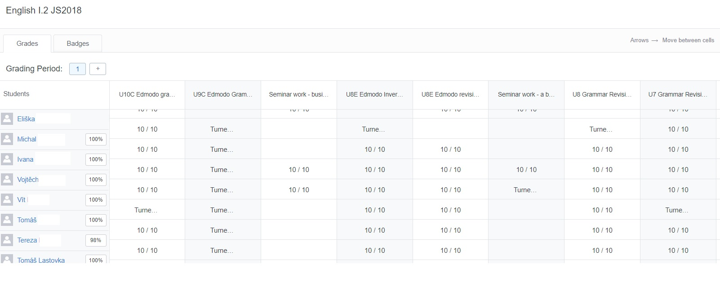
Edmodo.com

Slide 36
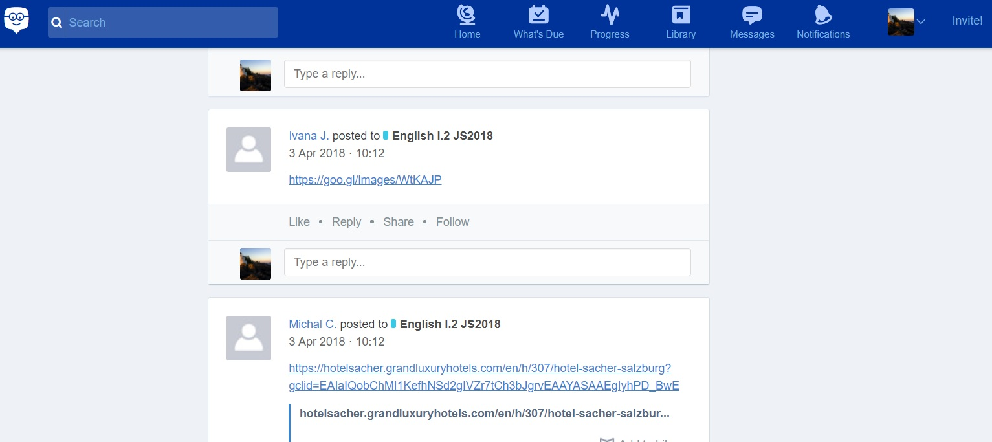
Edmodo In class
Collaboration in groups
Knowledge Building
Monitoring
Sharing
Evaluation

Slide 37
Students’ reactions

Slide 38
How often did you use Quizlet?

Slide 39
What did you learn?

Slide 40
Edmodo – students’ reaction

Slide 41
Edmodo and preparations for class

Slide 42
Edmodo and assignments

Slide 43
Edmodo and communication with T

Slide 44
Edmodo in classroom

Slide 45
Edmodo overall satisfaction

Slide 46
In summary

Slide 47
Thank you for your attention!

Slide 48
References
Articles
Kesen, A. (2010). Turkish EFL learners’ metaphors with respect to English language coursebooks. Novitas-ROYAL (Research on Youth and Language). 4, 108-118
Little, D. (2004). Democracy, discourse and learner autonomy in the foreign language classroom. Utbuldning & Demokrati, Vol. 13, N. 3, 105–126
Reinders H., Balçikanli, C. (2011). Do classroom textbooks encourage learner autonomy? Novitas-ROYAL (Research on Youth and Language), 5(2), 265-272
Images
https://www.alescenek.cz/zbozi/91730/business-proficiency/
https://antikvarium.cz/kniha/36131-anglictina-pro-samouky-1989
Online tools and sources
Economist.com
Edmodo.com
Quizlet.com

