Slide 1
Autonomy for absolute beginners
Raising awareness of learner autonomy on pre-service teacher training courses

Slide 2
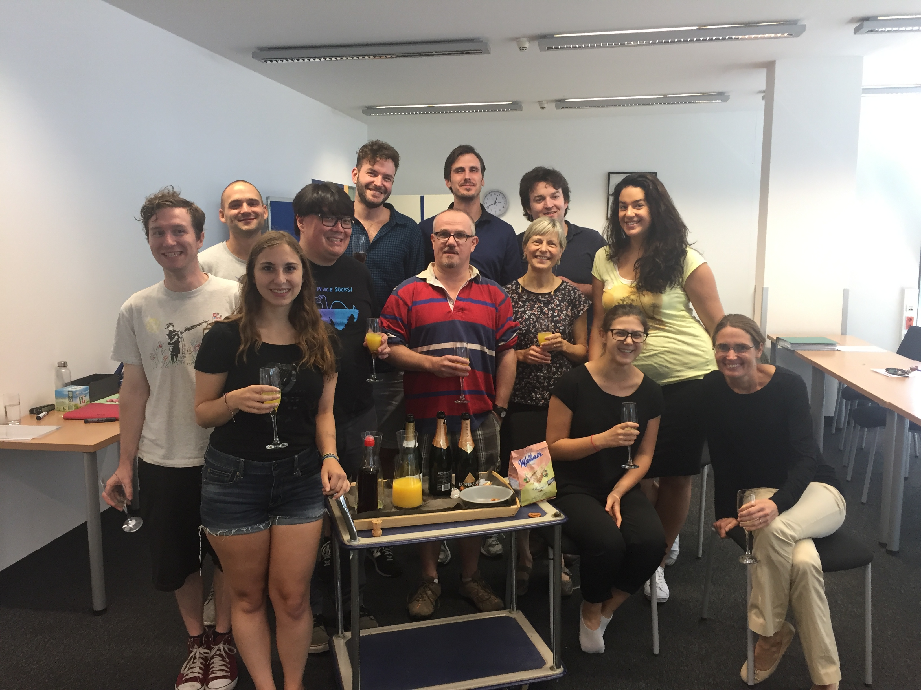

Slide 3
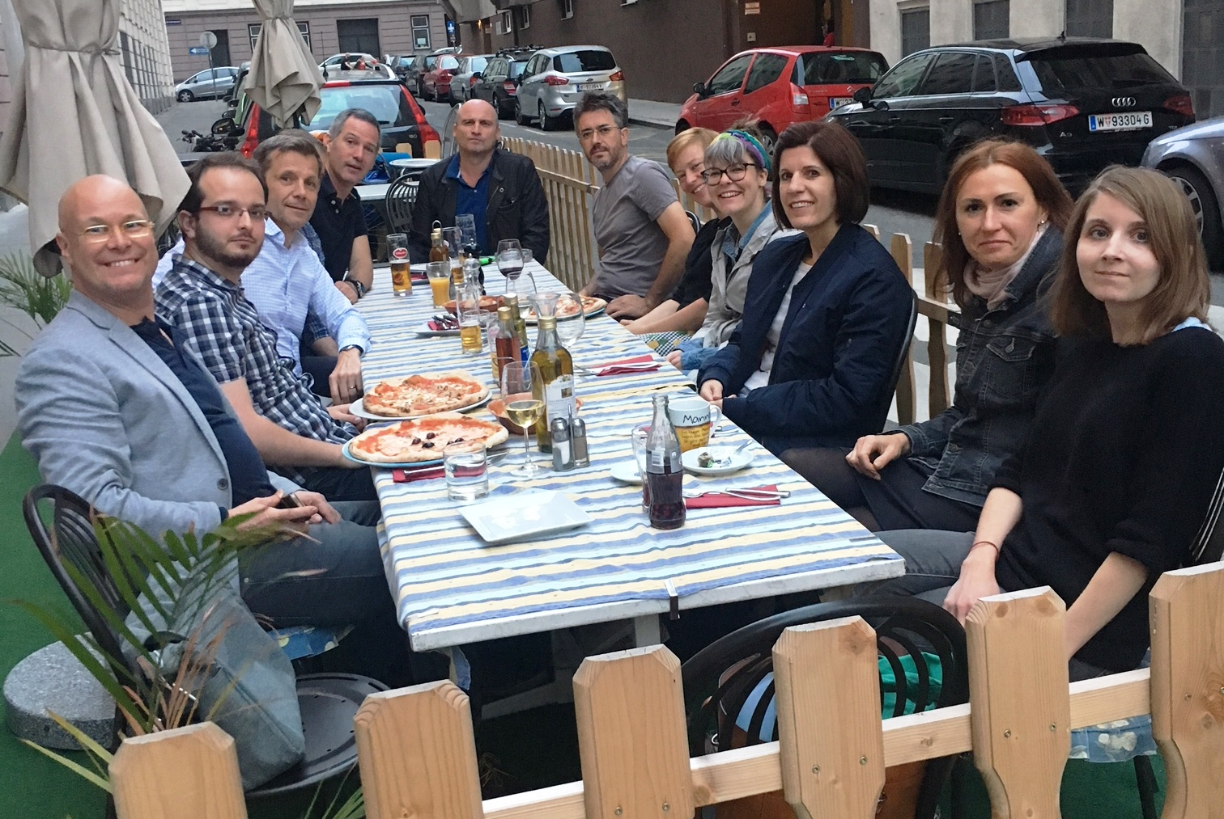

Slide 4
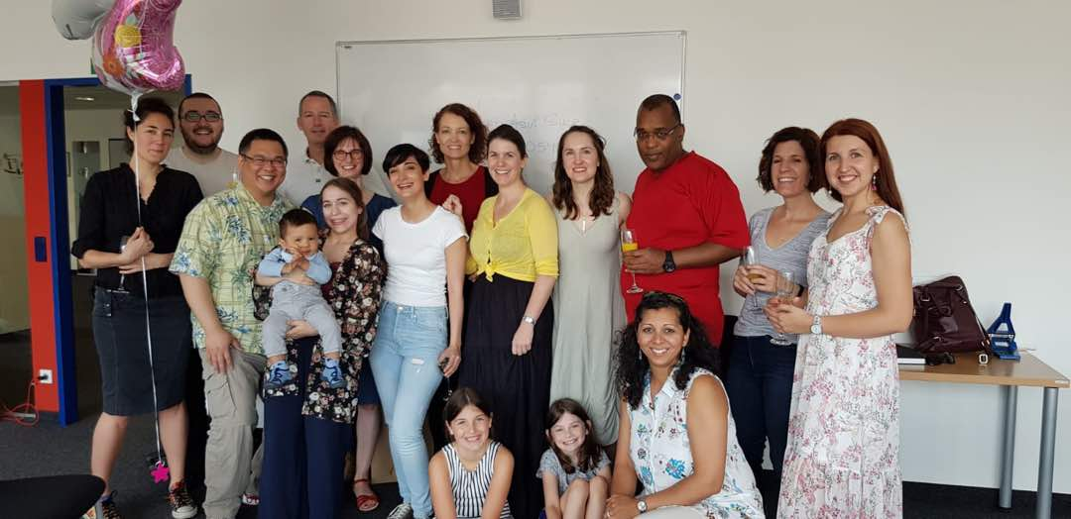

Slide 5
What did you notice?
They look pretty similar
They also act pretty similarly
They almost always have the same preconceived notions about teaching:
It is frontal and the teacher is the expert
The teacher corrects errors
Content is pre-determined and set in stone

Slide 6
So what’s a trainer to do?

Slide 7
First some terms
Trainee / Candidate
Trainer / Tutor
Student / Learner

Slide 8
Input sessions
What we say
What trainees hear
Differentiation
Scaffolding
Peer assessment
Blah blah blah
What’s the problem?
Too much, too soon, too complicated
Scepticism
King, A 1993, ‘From Sage on the Stage to Guide on the Side’, College Teaching, vol. 48, no. 1 (Winter 1993), pp. 30-35.

Slide 9
Input sessions: cutting our fluff
What we want
What we say (take two)
Differentiation
Scaffolding
Peer assessment
Everything depends on context
Support learners when necessary
Have students work with each other
What we do: walk the walk

Slide 10
Putting it into practice
Teaching practice, that is

Slide 11
Teaching practice: becoming hands on
Differentiation
Offer students a choice
Let students create their own tasks
Scaffolding
Demo tasks
Monitor but assist only when necessary
Let students ‘cook’
Peer assessment
Use think-pair-share
Encourage peer correction

Slide 12
Stumbling blocks to autonomy
Problems trainees have
Autonomy solutions
Scared that students won’t participate
Can’t answer questions learners ask
“Enjoy the silence”
Students as facilitators
Guided discovery: have students work their own way through the content

Slide 13
Extending learning
Teaching practice is done. What now?

Slide 14
Trainee reflection – the nitty gritty
Why?
Because we believe trainee reflection leads to learner autonomy ‘in the real world’
Because we want our trainees to be active learners
How?
It must be taught
It needs to be action-oriented

Slide 15
Reflection form

Slide 16
In closing
Trainees’ thoughts about autonomy:
Trainees are fulfilled, but they have to change their ideas about teaching
Trainees become more independent, but they still think they need more guidance from tutors
Trainers’ thoughts on introducing autonomy:
Respect the learning process
“Never change a working system”
Your thoughts:
Any other ideas?

