Slide 1
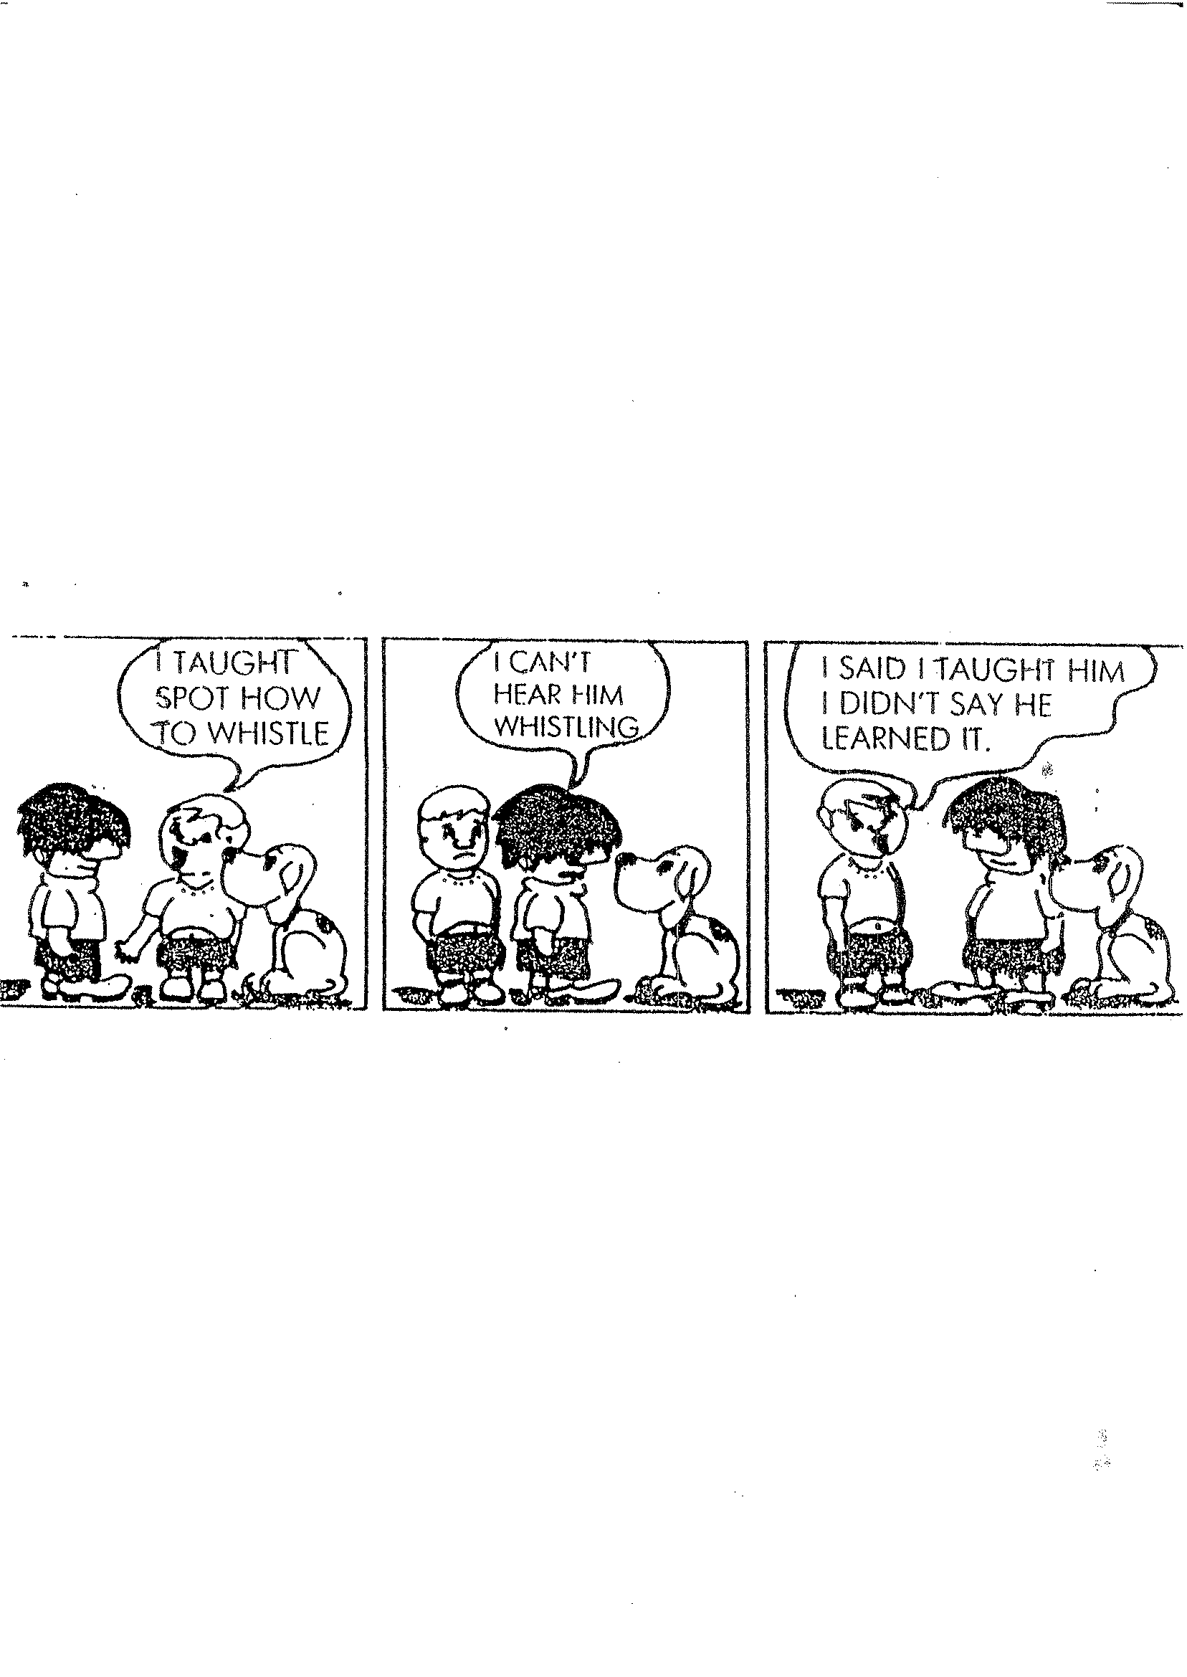
1973
“To learn is to develop relationships between [what the learner knows already and the new system being presented to him], and this can only be done by the learner himself.” (Barnes 1976:81)

Slide 2
Developing language learner autonomy:
The role of the teacher
Leni Dam, Karlslunde, Denmark
lenidam@hotmail.com

Slide 3
Some definitions
Learner autonomy is characterized by a willingness and capacity to take charge of one’s own learning. (cf. Dam 1995:1)
Language learner autonomy stresses the view that the learner's agency is – as far as possible - channelled through the target language. (Little 2007:26)
The role of the teacher: Language learner autonomy does not entail an abdication of initiative and control on the part of the teacher: she remains responsible for ensuring that learning happens. (cf. Little 1991; Dam 2003)

Slide 4
Developing Language Learner Autonomy (Dam 1995)
Plan what to do
↓
Carry out the plans
↓
Evaluate the outcome
↓
Decide on next step
↓
Dialoque / Interdependence
Teacher
initiated/ directed
Learner
Initiated/ directed
A cycle in action research

Slide 5
The teacher as action researcher
What is the challenge?
What will / can I do about it?
With what result?
Next step?

Slide 6
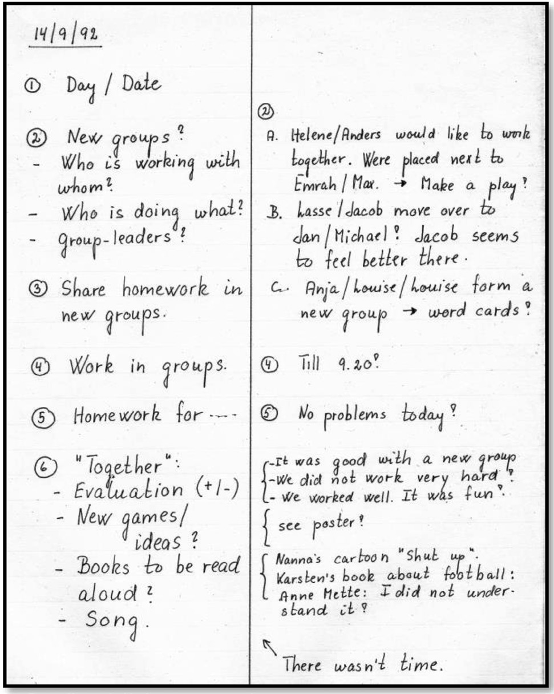
Teacher’s log
Plan
Action
Teacher’s observa-tions
New cycle: New groups
Previous action cycle
Teacher’s observation
Previous action cycle
Students’ reflections
“Together”: time for joint evaluation, presentations.
Actual presentations
Teacher’s evaluation

Slide 7
Beginning of a circle: Starting project work – taken from ‘It’s up to yourself if you want to learn (Dam&Lentz

Slide 8
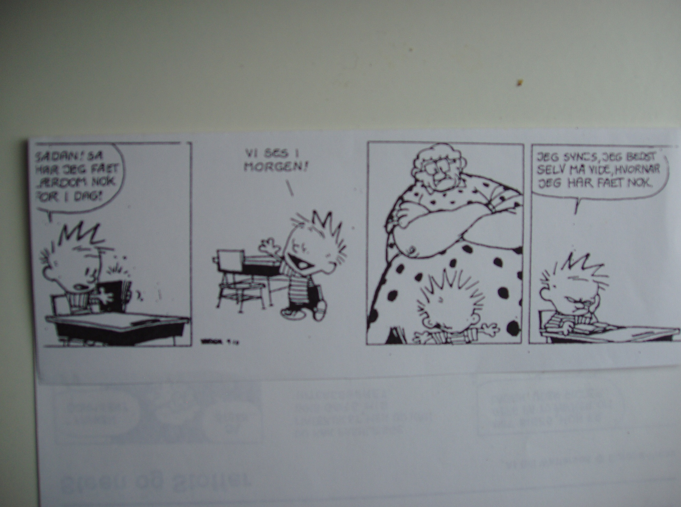
Making students willing to take over responsibility
That’s it! Enough for today!
See you tomorrow!
I thought I could decide myself!
Make the students feel secure and at ease:
Make expectations and demands clear (provide structure),
draw upon your students’ previous knowledge, make use of what they bring to the classroom,
give them possibilities for choice (activities, partners),
show them respect, take what they say at face value.

Slide 9
Making students capable of taking over responsibility
Set up structures / guidelines: for a lesson including working with a course book, for working in groups, for documenting learning, for keeping a logbook, for evaluation and assessment.
Make demands and expectations visible: curricular guidelines, documentation of learning , rules for homework.
Initiate awareness of learning: get learners to make decisions e.g. choice of activity, partner, homework.
Be a model: use the TL, document teaching and learning, respect your students and their time.

Slide 10
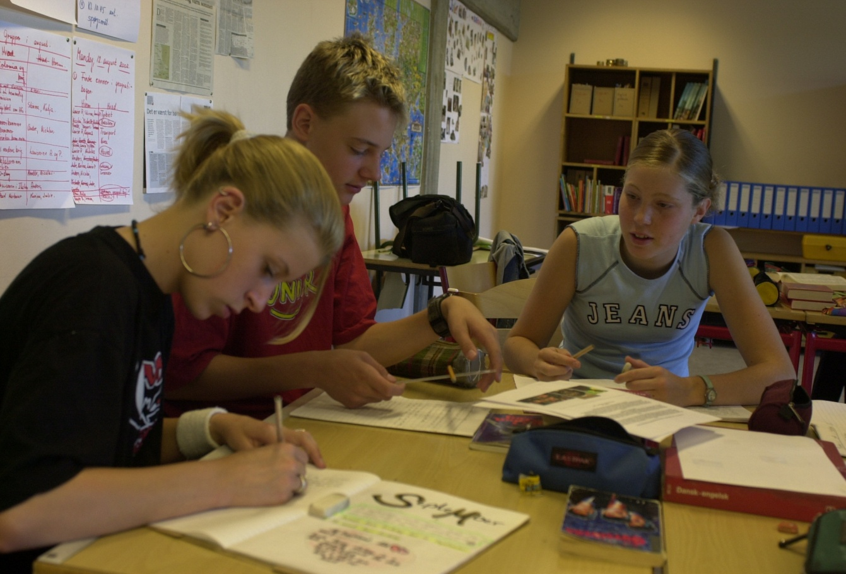
Seating in groups
Posters
Portfolios
Peer-tutoring
Group work
Logbooks
Independence of teacher
Reference book

Slide 11
Peer-tutoring – an example Taken from: ‘It’s up to yourself if you want to learn (Dam & Lentz)

Slide 12
Posters
What to do
A good talk

Slide 13
Structure of a lesson / period
Teacher’s time
Introducing new “musts”, new activity types, overview of lesson/period – no “teaching”
Students’ time
Individual work, pair work, group work - but placed in groups
Together time
Presentations, songs, quizzes, films, story-telling, games, joint evaluation.
2 minutes’ talk
Share homework
Work with chosen activities within given possibilities and/or according to plan
Decide on homework
Perhaps plan next lesson
Evaluation (individual, pair or group)
Cf. It’s up to yourself if you want to learn

Slide 14
Documentation of learning: The learners’ logbooks
Day and date
What you do during a lesson – and with whom
Homework: Out-of-class activities
Evaluation: The outcome of your work
A ‘monthpage’: At the beginning of every month
(Dam 1995 : 10; Little, Dam, Legenhausen 2017: 2-3, 83-92)

Slide 15
A page from a logbook – 3rd year of English
1. 2 Minutes’ talk with my group.
We talked about the weekend.
2. Share home work with Michelle.
Michelle has found 5 new words.
3. Free activities with my group:
we will work on our play.
4. Home work: Continue my story.
5. Evaluation: - l-------------------l---l +
because Leni has helped us to correct our mistakes.
6. Make small storys in groups. (directly copied)

Slide 16
Specific concerns in evaluation
Making use of the target language
What is a good talk?
Focus on the social aspect of learning
What is a good partner/ good group work?
Focus on the role of the teacher
What is a good teacher?

Slide 17
What is a good teacher?
Human / social values:
Is nice and honest with the students (7), trusts the students, Is patient (2), listens to her students, helps all the students, doesn’t forget what she has promised a student.
Professional values:
Sees to it that the students learn something/a lot (5), helps when the students need it (5), is devoted to her work (2).
Behaviour / performance:
Tells the students off when it is needed, can manage the students, doesn’t shout at the students (3), doesn’t get sulky.
(Some answers from students in their 2nd year of English – translated from Danish.)

Slide 18
Developing LLA = action research
Teacher initiated / directed
Dialogue
Interdependence
Learner initiated / directed
(Hopkins 2008, Lewin 1946)

Slide 19
Important issues in the process
Stop teaching – Support learning – Reduce TTT
Each new action cycle towards the development of LLA is determined by the reflections from the previous cycle – and is a never-ending process.
Don’t be afraid of ‘letting go’. Trust that your learners are capable of ‘taking hold’.
Make them researchers of their own learning.
(Dam 1995; Little, Dam, Legenhausen 2017)

Slide 20
Result: A student’s voice!
“Most important is probably the way we have worked. That we were expected to and given the chance to decide ourselves what to do. That we worked independently. And we have learned much more because we have worked with different things. In this way we could help each other because some of us had learned something and others had learned something else. It doesn’t mean that we haven’t had a teacher to help us. Because we have, and she has helped us. But the day she didn’t have the time, we could manage on our own.” (Max, end of term evaluation, 5th year of English)
(Dam 2006)

Slide 21
References and further reading
References and further reading
Barnes, D. (1976). From Communication to Curriculum. London: Penquin books.
Dam, L. (1995). Learner autonomy: From theory to classroom practice. Dublin: Authentik.
Dam, L. (2006). “Developing learner autonomy – looking into learners’ logbooks”. In: Kötter, M., Traxel, O, and Gabel, S. (eds.) Investigating and Facilitating Language Learning. Trier: Wissenschaftlicher Verlag, pp. 265-283.
Dam, L. and Legenhausen, L. (2009). “Evaluative activities as tasks – an example of action research in an autonomous classroom.” In: Altmayer, C., Mehlhorn. G., Neveling, C., Schlüter, N. and Schramm, K. (eds.) Grenzen überschreiten: sprachlich-fachlich-kulturell. Baltmannsweiler: Sneider-Verlag Hohengehren, pp. 243-254.
Dam, L. and Legenhausen, L. (2011). "Explicit reflection, evaluation, and assessment in the autonomous classroom." Innovation in Language Learning and Teaching 5. 177-189.
Dam L. and Lentz, J. (1998). It’s up to yourself if you want to learn (DVD). Karlslunde: Askeladden.)
Elliott , J. (1991). Action Research for Educational Change. Milton Keynes: Open University
Hattie, J. (2009). Visible Learning. A synthesis of over 800 meta-analyses relating to achievement. London: Routledge
Hopkins, D. (2008). A Teacher's Guide to Classroom Research. Maidenhead: Open University Press.
Legenhausen, L. (2013). “Classroom research in autonomous language learning.” In: Menegale, M. (ed.) Autonomy in Language Learning: Getting learners actively involved. IATEFL: Canterbury.
Little, D. (2001). “We’re all in it together: Exploring the interdependence of teacher and learner autonomy.” In: Karlsson, L., Kjisik, F. and Nordland. J. (eds.) All together now – Papers from the 7th Nordic conference and workshop on autonomous language learning Helsinki. Helsinki: Helsinki University Press.
Little, Dam and Legenhausen (2017). Language learner Autonomy: Theory, Practice and Research. Bristol: Multilingual Matters.
Lewin, K. (1946). "Action research and minority problems." Journal of Social Issues 2. 34-46.
Lewin, K. (1948). Resolving Social Conflicts. New York: Harper and Row Publishers.
Stenhouse, L. (1975). An Introduction to Curriculum Research and Development. London: Heinemann.
Trim, J. (1988). Preface. In: Holec, Henry (ed.). Autonomy and Self-directed Learning: Present Fields of Application. Strasbourg: Council of Europe, p. 3.
Barnes, D. (1976). From Communication to Curriculum. London: Penquin books.
Candlin&Mynard publishers: Autonomy in Language Learning Series (see flyer)
Dam, L. (1995/2004). Learner autonomy: From theory to classroom practice. Dublin: Authentik/Karlslunde: Askeladden.
* Dam, L. (2003). “ Developing learner autonomy: The teacher’s responsibility”. In: Little, D., Ridley, J. and Ushioda, E. (eds.) Learner autonomy in the Foreign Language Classroom. Dublin: Authentik, pp. 135-146.
Dam, L. (2006). “Developing learner autonomy – looking into learners’ logbooks”. In: Kötter, M., Traxel, O, and Gabel, S. (eds.) Investigating and Facilitating Language Learning. Trier: Wissenschaftlicher Verlag, pp. 265-283.

Slide 22
Dam, L. and Legenhausen, L. (2009). “Evaluative activities as tasks – an example of action research in an autonomous classroom.” In: Altmayer, C., Mehlhorn. G., Neveling, C., Schlüter, N. and Schramm, K. (eds.) Grenzen überschreiten: sprachlich-fachlich-kulturell. Baltmannsweiler: Schneider-Verlag Hohengehren, pp. 243-254.
Dam, L. and Legenhausen, L. (2011). "Explicit reflection, evaluation, and assessment in the autonomous classroom." Innovation in Language Learning and Teaching 5. 177-189.
Dam L. and Lentz, J. (1998). It’s up to yourself if you want to learn (DVD). Karlslunde: Askeladden. Adapted version on YouTube: Language Learner Autonomy – In Action. See: Multilingual Matters, YouTube.
Hopkins, D. (2008). A Teacher's Guide to Classroom Research. Maidenhead: Open University Press.

Slide 23
Legenhausen, L. (2013). “Classroom research in autonomous language learning.” In: Menegale, M. (ed.) Autonomy in Language Learning: Getting learners actively involved. IATEFL: Canterbury.
Lewin, K. (1946). "Action research and minority problems." Journal of Social Issues 2. 34-46.
* Little, D. (1991). Learner autonomy: Issues and definitions. Dublin: Authentik.
* Little, D. (2007). “Language Learner Autonomy: Some Fundamental Considerations Revisited”. In: Innovation in Language Learning and Teaching 1. 14-29
Little, D., Dam, L. and Legenhausen, L. (2017). Language learner Autonomy: Theory, Practice and Research. Bristol: Multilingual Matters.
* These titles are available on:
https://www.researchgate.net/profile/David_Little2

